Slide 1
PROJECT 1: SUMMER OLYMPICS
Team Members:
Valerie Pippenger
Diana Kennen
Damiso Hutchinson
Andrew Miller
Caroline Larry

Slide 2
Data Analysis
Demographic Analysis Topics:
How many total medals has each country earned? Over time?
How many medals has each gender won over time?
How many different sports have awarded medals over time?
Which countries tend to win at what sports?
Does a country’s GDP change after hosting the Olympics?
Correlation Analysis:
How does country GDP correlate with the number of medals?
Regression analysis of GDP and number of medals.

Slide 3
Hypothesis: There is a positive correlation between a country’s GDP and the total number of medals its athletes have received.

Slide 4
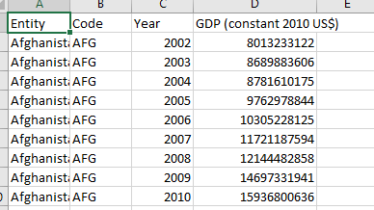
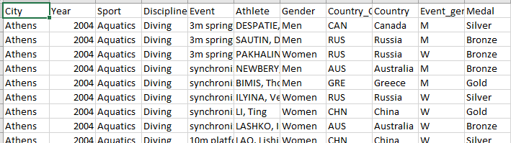
Data Sources
Gross domestic product adjusted for price changes over time (inflation) and expressed in US-Dollars.
Summer Olympics Medals (1976-2008)
11256 Data Rows
15316 Data Rows

Slide 5
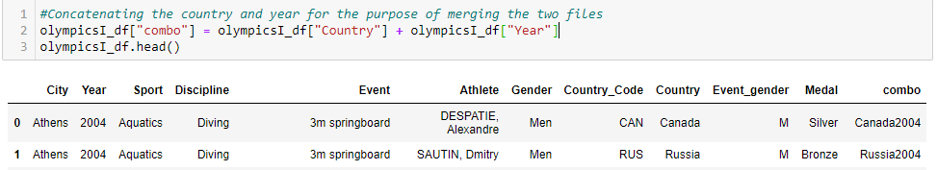
Merging
We concatenated the country and year to create a merge point for both files.
We used a left merge on the country-year combo.

Slide 6
Cleaning
Due to name changes of Eastern European Countries; GDP is missing for certain entries
Dropping Missing Data
Converting file types to match
Correcting Country Names to match GDP
Data rows with missing GDP were left in so medal analysis could still be completed
Creating a function for assigning host country (not just city)
Fixing big gap in csv file
Dropping duplicate columns (country names, codes)

Slide 7
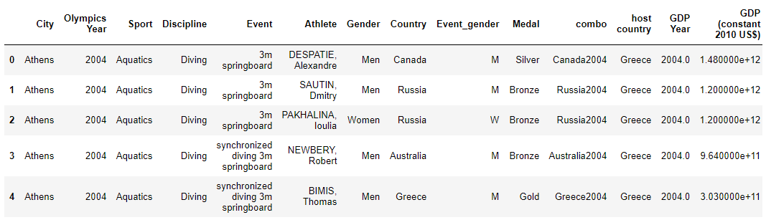
Cleaned DataFrame

Slide 8
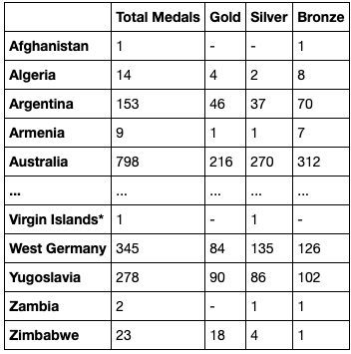
Medal count by country breakdown
There were a total of 127 countries that participated in the Olympic games 1976-2008

Slide 9
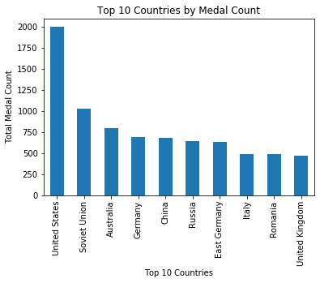
Top 10 Countries by Medal Count
United States : 1,992
Soviet Union : 1,021
Australia : 798
Germany : 691
China : 679
Russia : 638
East Germany : 626
Italy: 486
Romania: 482
United Kingdom : 467

Slide 10
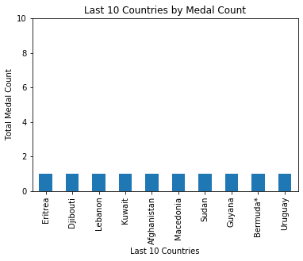
Last 10 Countries by Medal Count
Eritrea : 1
Djibouti : 1
Lebanon : 1
Kuwait : 1
Afghanistan : 1
Macedonia : 1
Sudan : 1
Guyana : 1
Bermuda : 1
Uruguay : 1

Slide 11
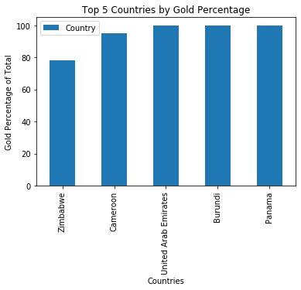
Top 5 Gold Percentage
These countries had the highest percentage of Gold medals:
United Emirates: 100%
Burundi: 100%
Panama: 100%
Cameroon: 95%
Zimbabwe: 78%

Slide 12
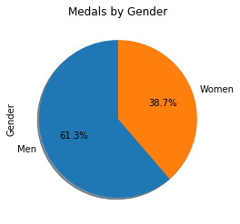
Medals by Gender
Men : 9,388
Women : 5,928

Slide 13
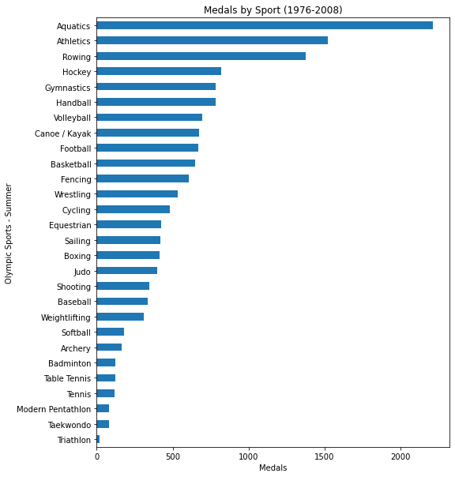
Medals Won by Sport 1976 – 2008 Aquatics wins the most summer Olympic medals and includes 26 separate events

Slide 14
Top 10 Countries by Sport
The winningest countries in the summer olympics tend to be the more developed countries
While the USA is dominant in commercialized sporting events like basketball and gymnastics, countries in Asia and the Middle East are the leaders in combat sports like Judo
Countries that descend from romance languages are more dominant in sports like football (soccer), volleyball, and water sports

Slide 15
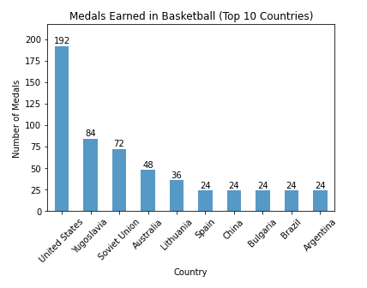
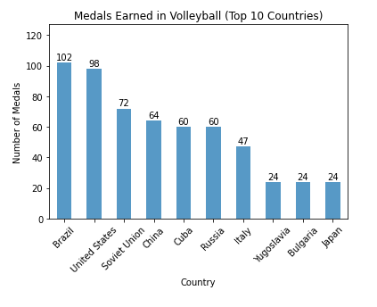
Top 10 Countries by Sport

Slide 16
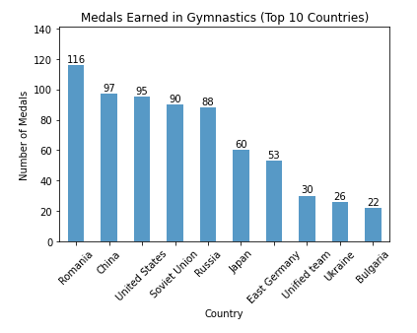
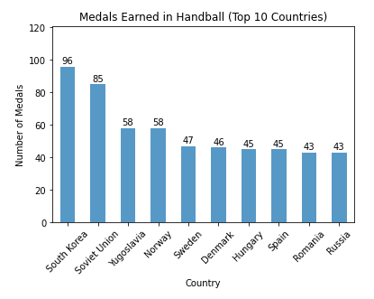
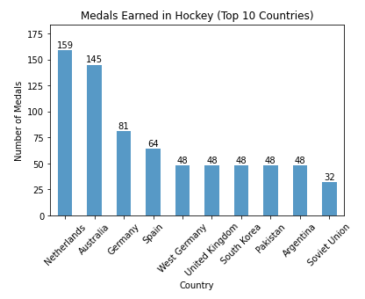
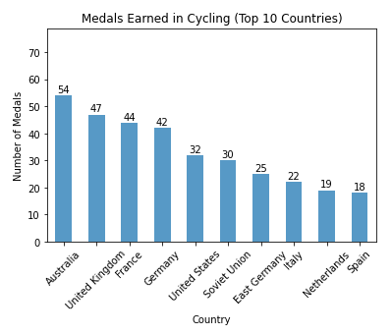
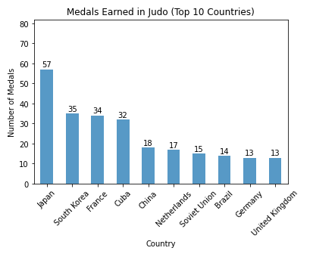
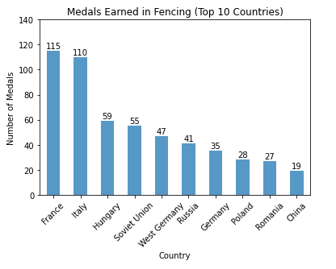

Slide 17
How Does a Country’s GDP Change After Hosting Olympics?

Slide 18
Host Country GDP Change After Hosting
Looking at short term GDP growth, host country GDP increases after hosting the olympics
The two countries whose GDP dropped are Russia (Soviet in 1980) and Spain
There are a number of factors that can contribute like socio-political climate, the infrastructure in place, country violence, etc., however, we strictly looked at GDP before and after hosting the olympics

Slide 19
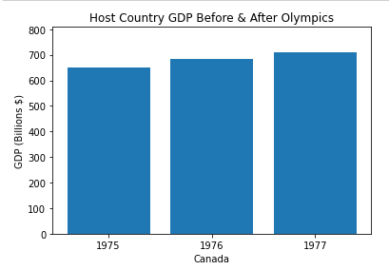
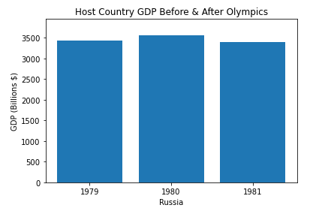
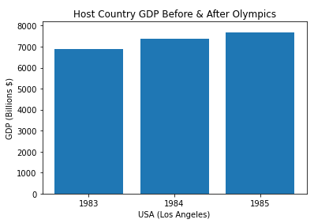
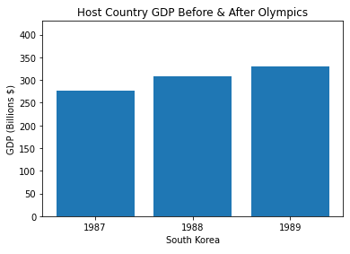
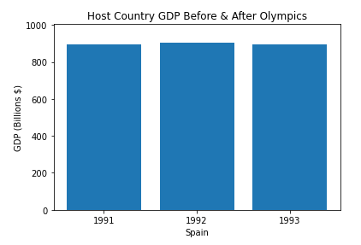
Host Country GDP Change After Olympics

Slide 20
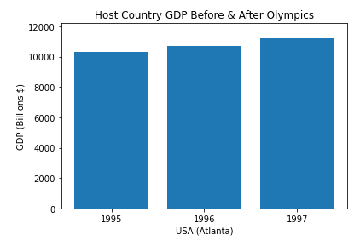
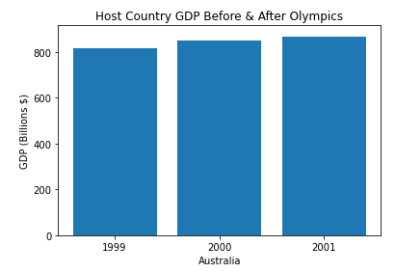
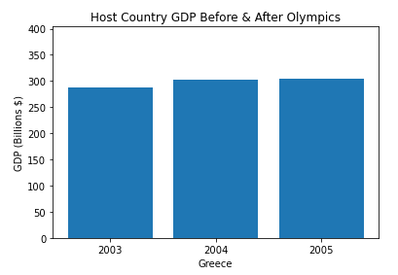
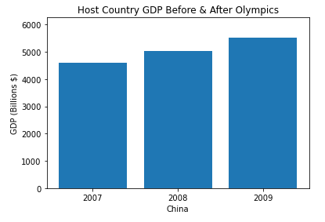

Slide 21
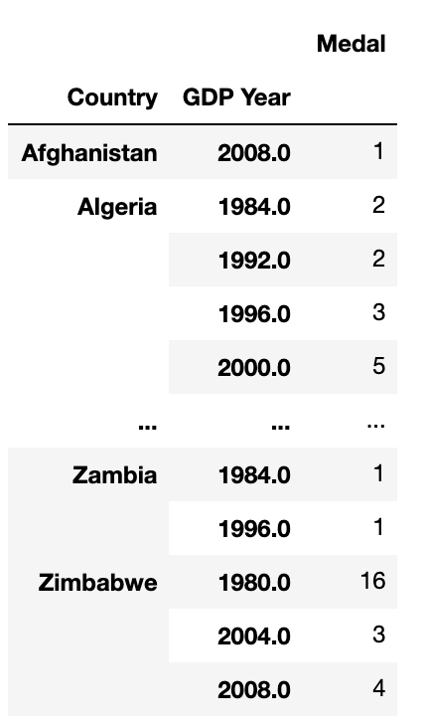
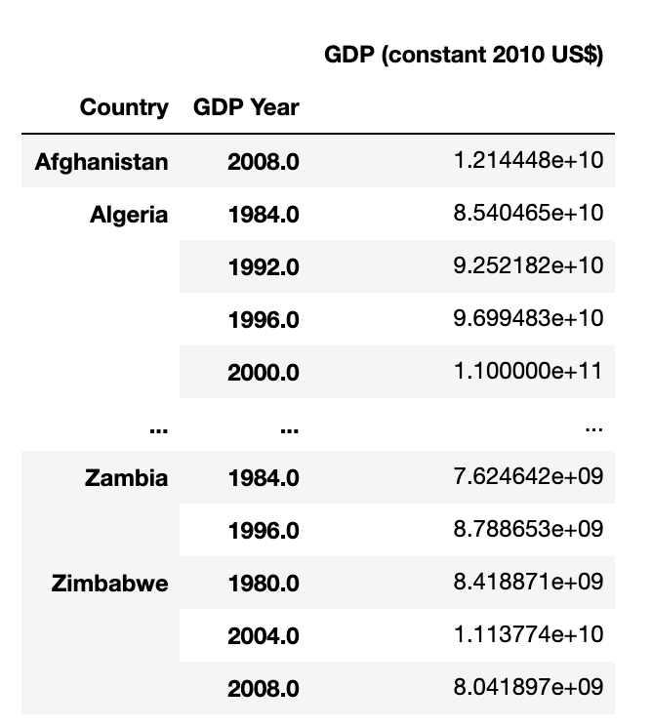
Correlation Between Country GDP and Medals Won

Slide 22
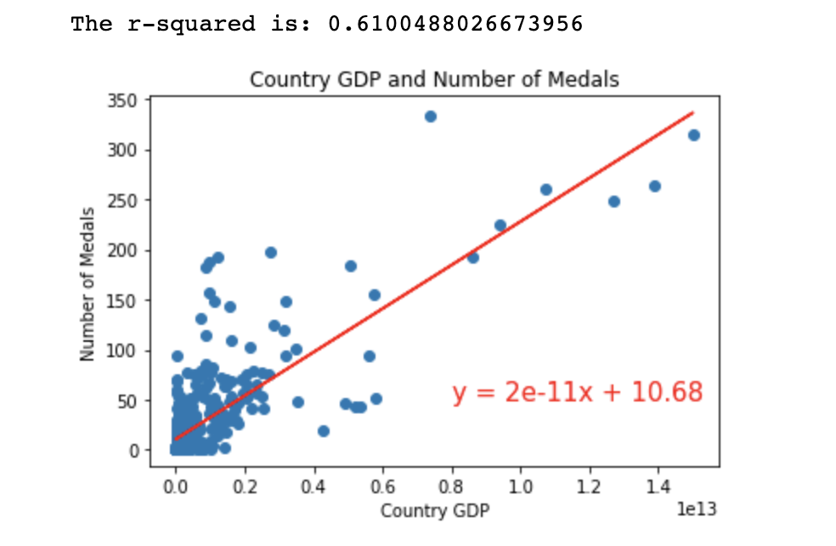

Slide 23
Hypothesis: There is a positive correlation between a country’s GDP and the total number of medals its athletes have received.
Our hypothesis is supported. Data shows that countries with higher GDPs do win more medals.

